Slide 1
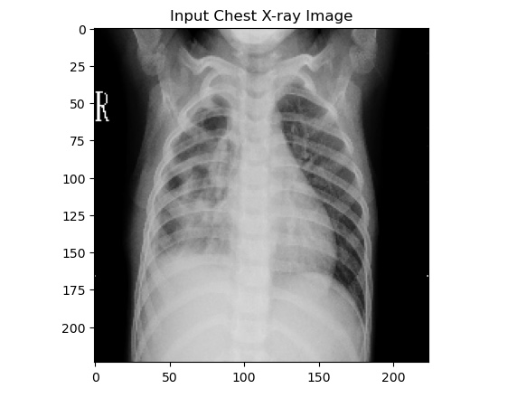
PNEUMONIA DETECTION FROM CHEST X-RAYS USING DEEP LEARNING
PRESENTED BY: BHUSHAN KHUSHAL NIMJE
GUIDED BY: SAURAV KUMAR

Slide 2
CONTENT
CONVOLUTIONAL NEURAL NETWORKS (CNN)
DATASET
MODEL DEVELOPMENT
TRAINING AND EVALUATION
RESULT
CONCLUSION

Slide 3
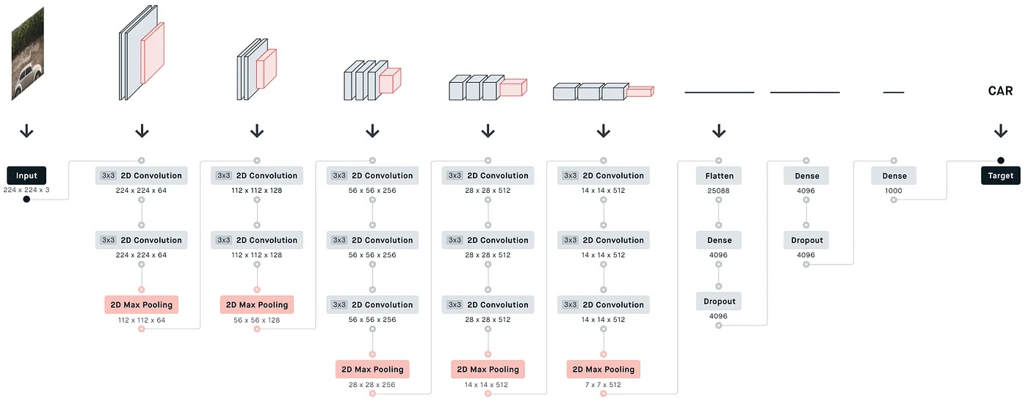
CONVOLUTIONAL NEURAL NETWORKS (CNN)
CNN is a part of deep learning which is designed to automatically extract the important features of input images.
Convolutional Neural Networks extract features from images by applying filters to detect patterns.
Pooling layers reduce dimensionality and computational complexity while retaining important features.
Batch Normalization normalizes the output of a previous activation layer by re-centering and re-scaling the inputs. It helps in stabilizing and speeding up the training process.
Fully Connected Layers classify the image based on the features learned from the convolutional layers.

Slide 4
DATASET
The dataset consists of images categorized into “Normal” and “Pneumonia” classes.
The total “Normal” images are 1341 and “Pneumonia” images are 3875.
Images were resized to uniform size 224 x 224 pixels suitable for input into the Convolutional Neural Networks (CNN).
Applied normalization to scale pixel values to the range [0,1].

Slide 5
MODEL DEVELOPMENT
Model Architecture Selection: Begin by selecting a suitable model architecture tailored to the problem. In this case, I explored multiple architectures, including custom CNN models and pre-trained models like VGG16, VGG19, ResNet50, and InceptionV3. Each architecture offers different strengths depending on the complexity and type of data.
Transfer Learning: Leveraging pre-trained models (e.g., VGG19, ResNet50, InceptionV3) allows for faster convergence and improved performance. By using models pre-trained on large datasets like ImageNet, you can fine-tune the network to perform well on the specific task of pneumonia detection.
Model Compilation: After defining the architecture, compile the model by selecting appropriate loss functions and optimizers. For binary classification tasks like this, the 'binary_crossentropy' loss function combined with the 'Adam' optimizer is effective in ensuring robust training.

Slide 6
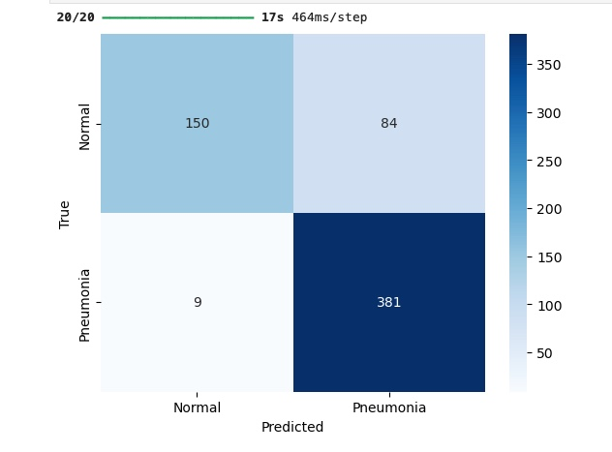
TRAINING AND EVALUATION
We trained the dataset with four CNN models which are VGG16 which was custom built in which batch normalization layer was added. Pre-Trained models like VGG19, ResNet50 and InceptionV3.
The models were trained for 25 epochs using Adam optimizer and binary cross entropy loss.
The models were tested on validation dataset for finding the validation accuracy.
Computed confusion matrix and classification report for detailed evaluation.

Slide 7
RESULT
The Inceptionv3 model effectively classified images into “Normal” and “Pneumonia” categories demonstrating strong performance in distinguishing between two medical states.

Slide 8
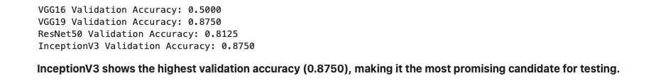
CONCLUSION
Developed a CNN image classifier with four CNN architectures which are custom built VGG16 and pre-trained VGG19, ResNet50, InceptionV3.
After testing all the models on validation dataset InceptionV3 performed better as compared to other CNN architectures,
Validation accuracy obtained by InceptionV3 was 0.8750 which was highest and lowest validation accuracy was obtained by VGG16 architecture.
The project highlights the effectiveness of deep learning in medical field which will help doctors and patience to take decision properly.

Slide 9
THANK YOU

